Slide 1
Concepts in Data Analytics

Slide 2
Outline
Concepts in Data Analytics
Dataset
Features
Labels

Slide 3
Dataset
Collection of data that follows a similar template
In this course, we focus on tabular datasets
Also called structured data – a dataset is organized as rows and columns
Rows represent specific objects (instances, samples) in the data
Columns represent features (attributes, variables) in the data
Columns represent features
Rows represent users
#Account | Balance | 3-month past due | 6-month past due | Credit Standing
3 | 120 | 0 | 0 | Good
1 | 100 | 120 | 0 | Good
5 | 1000 | 600 | 300 | Bad
3 | 300 | 100 | 0 | Bad
A dataset on credit rating

Slide 4
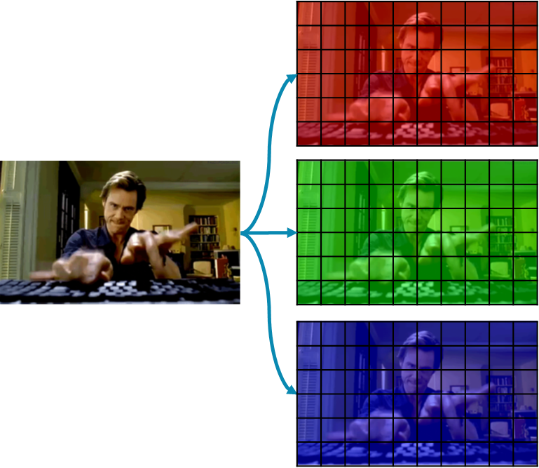
Other Types of Data
Tabular data is not the only types
Examples of other types are images, texts, graphs, etc.
5 | 1 | 3 | 8 | 9
1 | 0 | 0 | 8 | 1
0 | 7 | 5 | 3 | 1
8 | 2 | 5 | 9 | 8
It was the best of times, it was the worst of times, it was the age of wisdom, it was the age of foolishness, it was the epoch of belief, it was the epoch of incredulity, it was the season of Light, it was the season of Darkness, it was the spring of hope, it was the winter of despair, we had everything before us, we had nothing before us, we were all going direct to Heaven, we were all going direct the other way—in short, the period was so far like the present period, that some of its noisiest authorities insisted on its being received, for good or for evil, in the superlative degree of comparison only.
i | be | hello | It | …
0 | 5 | 0 | 5 | …
5 | 1 | 3 | 8 | 9
1 | 0 | 0 | 8 | 1
0 | 7 | 5 | 3 | 1
8 | 2 | 5 | 9 | 8
BOS
5 | 1 | 3 | 8 | 9
1 | 0 | 0 | 8 | 1
0 | 7 | 5 | 3 | 1
8 | 2 | 5 | 9 | 8
ORD
 | ATL | BOS | DCA | NYC | ORD
ATL | 0 | 946 | 547 | 762 | 606
BOS | 946 | 0 | 398 | 186 | 864
DCA | 547 | 398 | 0 | 204 | 610
NYC | 762 | 186 | 204 | 0 | 738
ORD | 606 | 864 | 610 | 738 | 0
NYC
DCA
ATL

Slide 5
Attribute Types
Numeric attributes are true numbers
Math functions and operations are meaningful when applying
Examples: income, price, age, length, width, etc.
Class/categorical attributes are discrete class
Nominal: values in this attribute do not have orders
Examples: states, locations, animal types, etc.
Ordinal: values in this attributes have orders
Examples: low/medium/high, strongly disagree/disagree/neutral/agree/strongly agree
Binary: the class has exactly two values
User ID | #Account | Balance | 3-month past due | 6-month past due | State | City | Zip Code | Credit Standing
1236512 | 3 | 120 | 0 | 0 | GA | Kennesaw | 30144 | Good
1395421 | 1 | 100 | 120 | 0 | GA | Atlanta | 30301 | Good
3984321 | 5 | 1000 | 600 | 300 | NY | NYC | 10001 | Bad
1268425 | 3 | 300 | 100 | 0 | FL | Tampa | 33605 | Medium

Slide 6
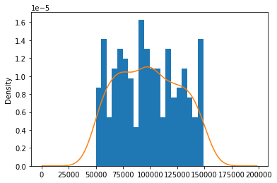
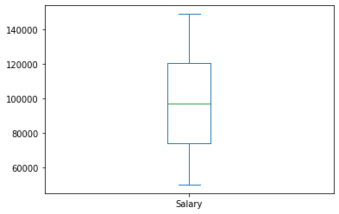
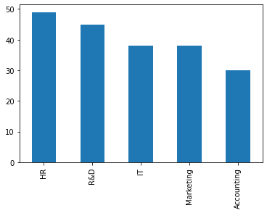
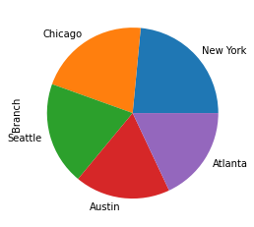
Data Distribution
Roughly speaking, refer to how values in a column distribute
For numeric columns, look at statistics like min, mean, median, max, standard deviation
Can visualize individual attributes using histograms or box plots
For class columns, look at frequency of each value in the class
Can visualize individual attributes using bar charts or pie charts

Slide 7
Numpy
A Python package that focuses on numerical manipulation of vectors, matrices, and tensors
In analytics, Numpy can be used to
Extract a portion of data, filter data
Some preliminary analysis and descriptive statistics
Data transformation
To install
In Windows, open a CMD window and run
pip install numpy
In Mac/Linux, open a Terminal window and run
sudo pip install numpy

Slide 8
Example Data Used in Jupyter Notebook
Employee ID | Age | Years at Work | Productivity | Salary
100320 | 36 | 5 | 97 | 110000
132201 | 30 | 3 | 95 | 105000
100212 | 45 | 12 | 95 | 133000
143695 | 27 | 1 | 90 | 80000
The rest of the lecture note is available in the provided Jupyter notebook

